Slide 1
B09S0061 Software Engineering
Lecture 1
Instructor: Liu, Guangchi Ph.D.
2025/02/21
Notes:
本模板基于“中国科学院大学-路人丁-PPT模板”魔改而成，著作权归该作者所有。
本模板中使用的东南大学校徽、校标文字组合、校训文字等素材来自于微信公众号“金木屋”。
本模板的视觉设计参考了“东南大学视觉识别系统”。
人物介绍页头像素材来自 小肥柴。
本模板力求简洁，布局合理，主次分明。以学术风为设计理念，适用于学术报告与论文答辩等相关应用场景。模板未使用任何动画效果。
您仅可以以个人非商业用途使用本PPT模板，不可将信息内容的全部或部分用以出售，或以出租、出借、转让、分销、发布等其他任何方式供其他人使用。
欢迎 持续关注东南大学止于至善学术风 PPT 模板 （https://zhuanlan.zhihu.com/p/335298500）后续的功能优化及多语言更新版本。
最后，祝汇报顺利，马到成功！
Version: (2021) v1.5-en.

Slide 2
01
PART ONE
Introduction & Syllabus

Slide 3
About Me
刘光迟 Professor, Ph.D. Advisor
Room 160, CS Building, Jiulonghu Campus E-mail: gc-liu[at]seu[dot]edu[dot]cn
More Info at: https://gc-liu.github.io/
Professional Experience
Jul. 2023 – Present:
Professor, Southeast University, China
Aug. 2022 – Jun. 2023:
Assistant Professor, Kennesaw State University, United States
Jun, 2017 – Jul, 2022:
Research Scientist/Sr. Director of Research, Stratifyd, Inc., United States
Stratifyd: Startup SaaS company, Social media data analytic systems
Research Interests
Social Computing and Security, Cyber Science and Engineering

Slide 4
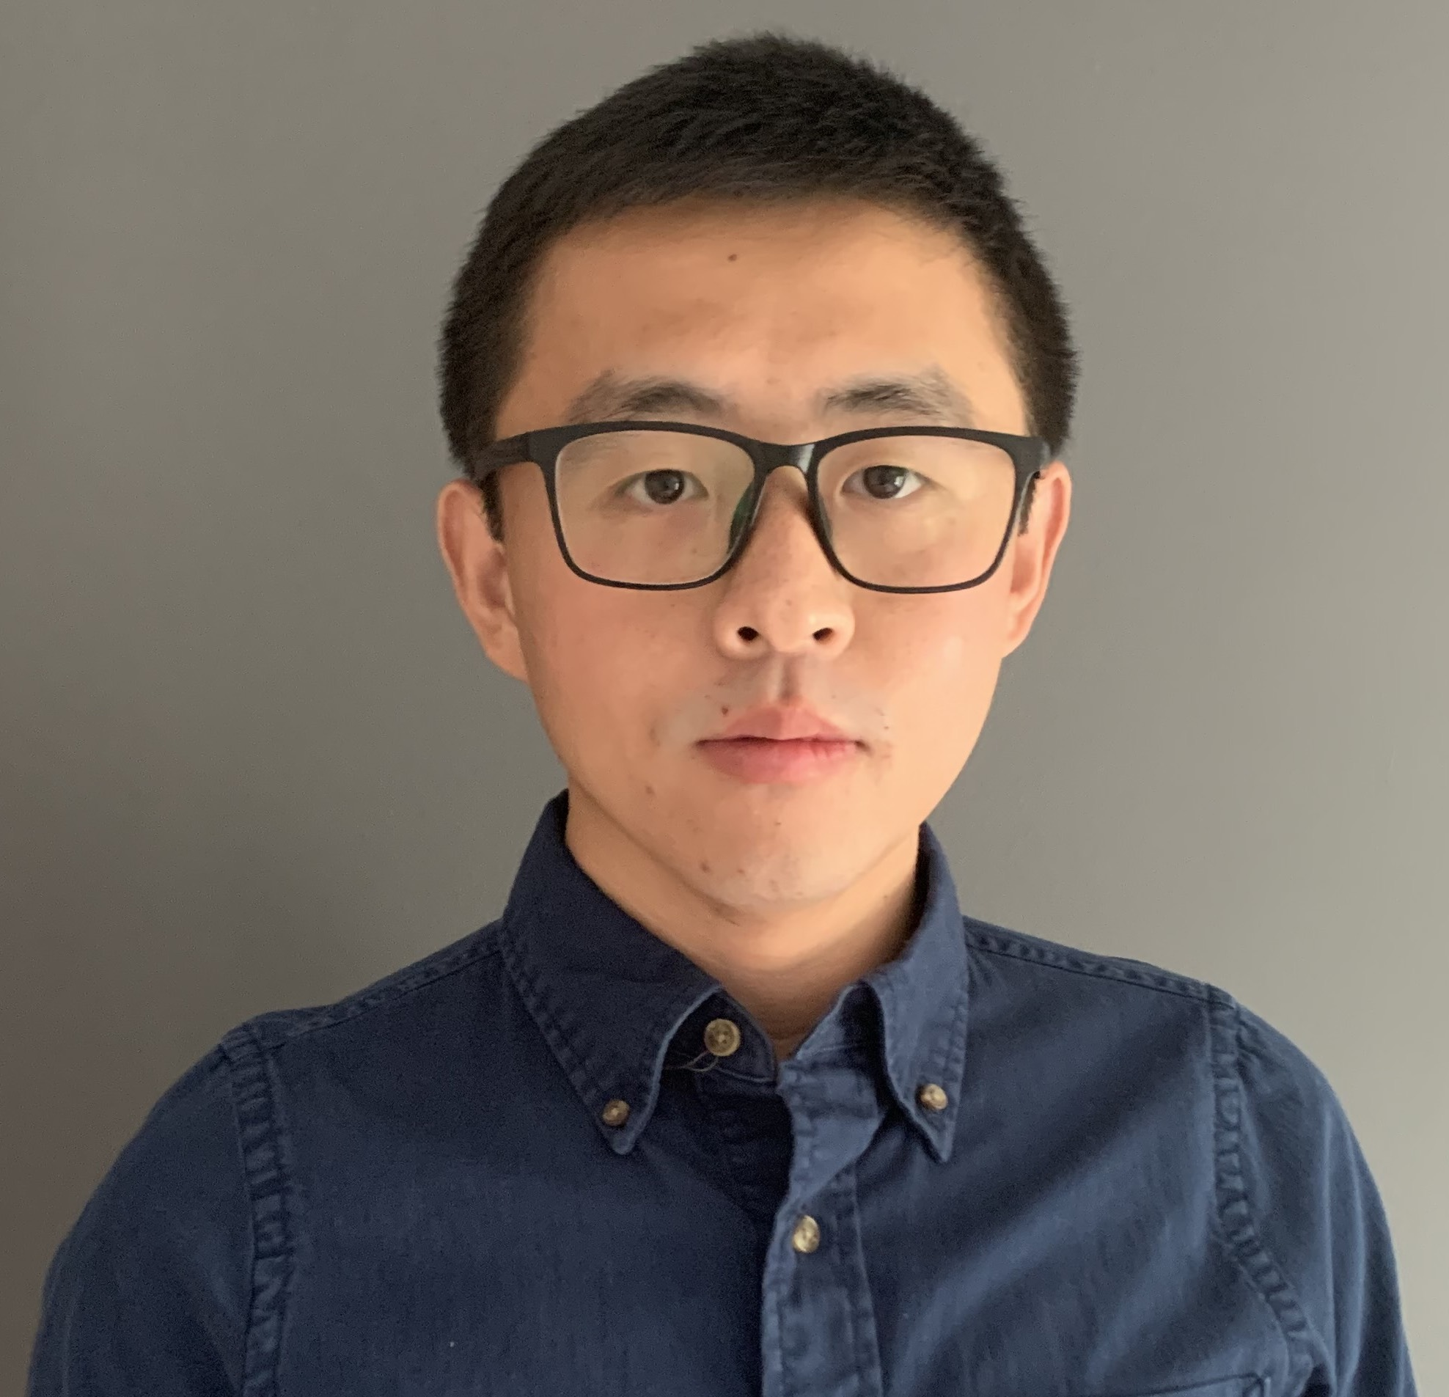
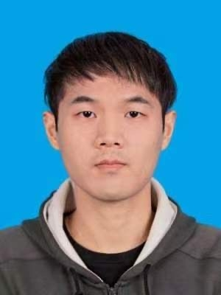

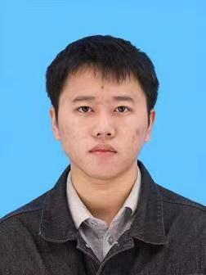
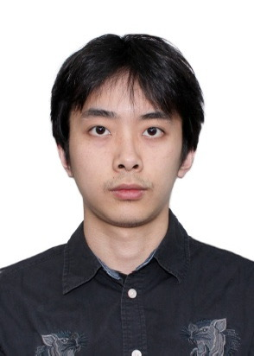
About the Team
Instructor
刘光迟
Teaching Assistant
宋一鑫 E-mail:
604462433@qq.com
江波 E-mail: jser1099@foxmail.com
王鑫超 E-mail:
512954172@qq.com
马子焓 E-mail: zihan_ma@seu.edu.cn

Slide 5
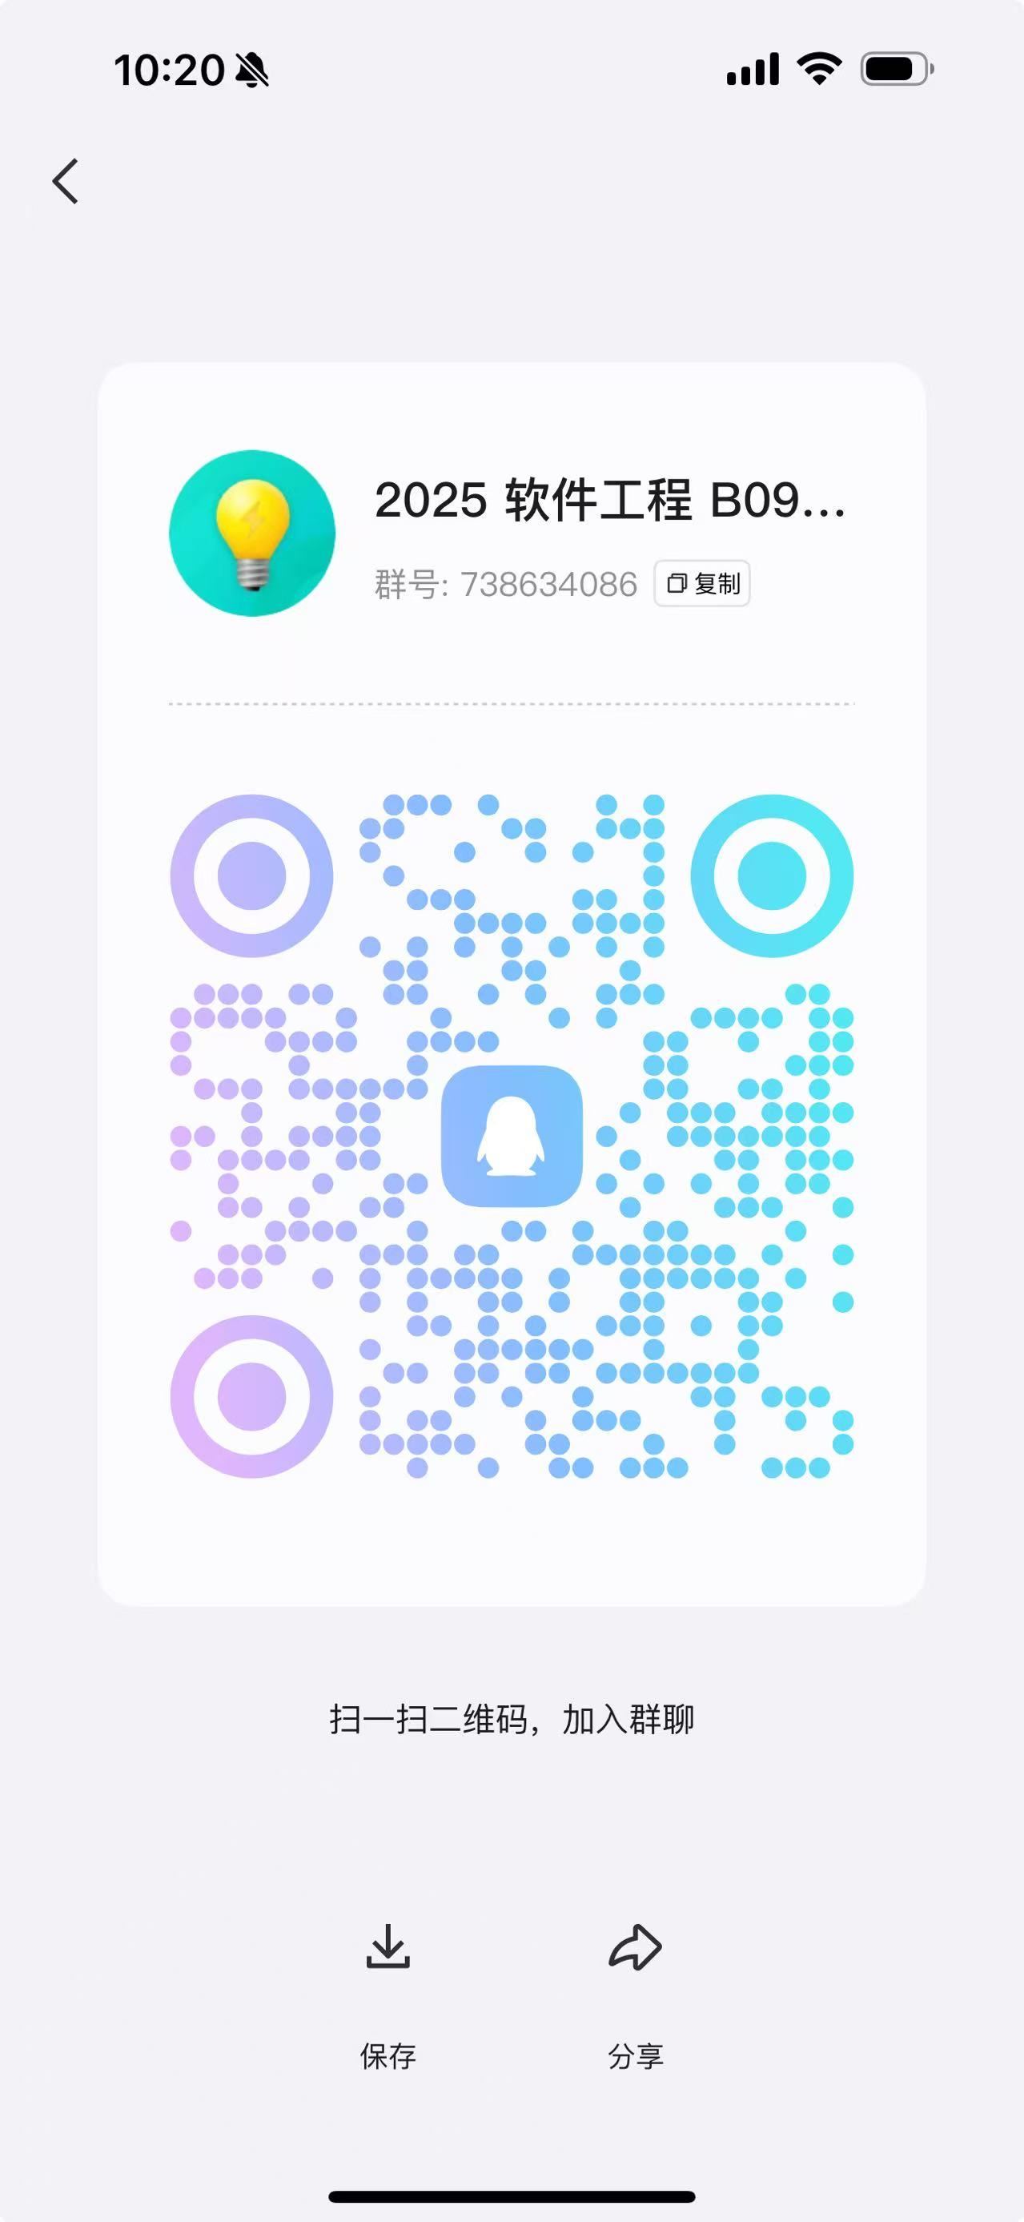
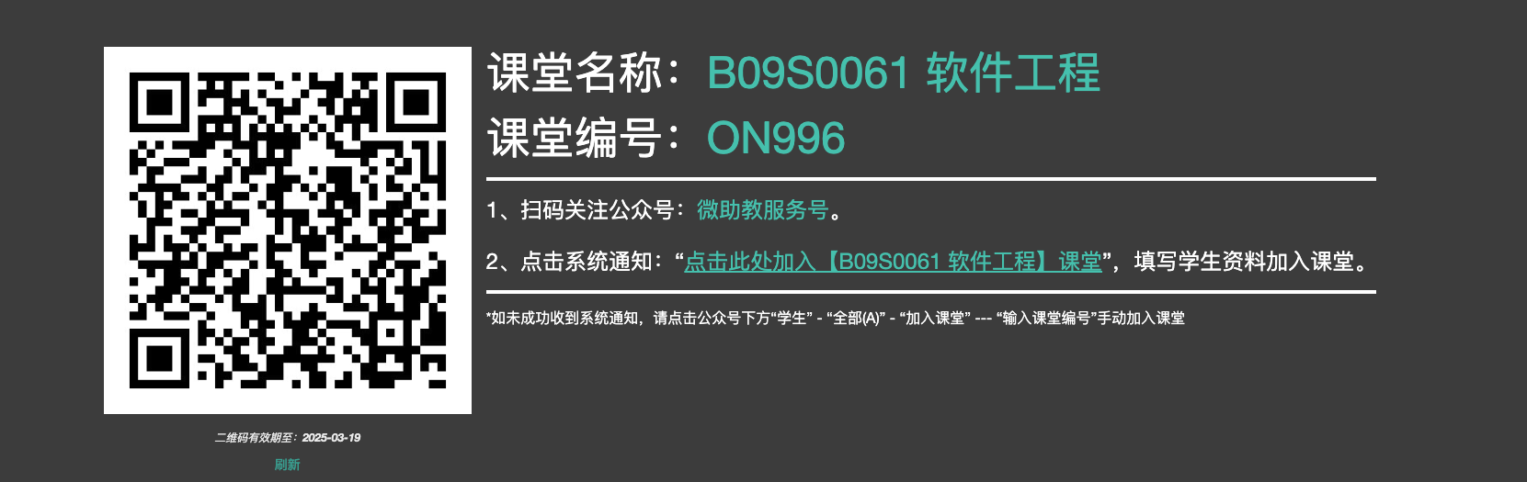
Join the Community
作业提交至 微助教 App
请在系统中完整填写你的学号和姓名
课程沟通QQ群：加群请注明 姓名_学号

Slide 6
Contents Covered in this Course^{[1,2,3]}
Introduction
Requirements
02
01
Process, Terminologies,
Tools
Analysis, Modeling
03
Design
Testing
04
UI, System, Program
Unit/ Integrated Test
05
Management
Legal, Risk, QA
[1] Software Engineering, Yue Chen, et al. Zhejiang University https://www.bilibili.com/video/BV16g411M7r2?p=1
[2] Software Engineering, Curran Muhlberger, et al. Cornell University, https://www.cs.cornell.edu/courses/cs5150/2022sp/
[3]伊恩·萨默维尔(Ian Sommerville).软件工程(原书第10版)，机械工业出版社 (2018-02出版)

Slide 7
Calender
Week # | Date | Topic | Lab
1 | 2.21 | Intro&Syllabus
2 | 2.28 | Software Process/Project Management
3 | 3.7 | Project Management/Requirement Engineering
4 | 3.14 | Requirement Engineering
5 | 3.21 | User Interface/Experience
6 | 3.28 | Models & Architecture | 3.29
7 | 4.4 （Holiday）
8 | 4.11 | Models & Architecture | 4.12
9 | 4.18 | Program Development
10 | 4.25 | Program Development | 4.26
11 | 5.2 | Program Development/Testing
12 | 5.9 | Testing | 5.10
13 | 5.16 | Testing
14 | 5.23 | Version Control
15 | 5.30 | Legal Aspects and Professionalism
16 | 6.6 | Course Review
In-Class Lesson:
Session 3-5 (9:50 ~ 12:15)
Week 1-16
Friday J6-101
Lab:
Session 6-9 (14:00 ~ 17:25)
Week 6-12 (Bi-Weekly)
Sunday, J6-101
Bring Your Laptop

Slide 8
Grading Scale
Attendance/In-Class Questions: 30%
Randomly pick students to answer my questions
Will lose points if you don’t show up or respond well (Second-major student is excluded)
4 take-home assignments
Score will be counted individually
Final Exam: 40%
Basic concepts and understandings
Single-choice, true/false and short-answer questions
Closed-book exam
Score will be counted individually

Slide 9
Grading Scale
Project: 30%
Accomplish an industrial project, e.g., developing a SaaS App on cloud
4 ~ 6 students a team
Claim your Project Name, Team Name, Members in Team Info (QQ 群在线文档)
Follow the process learned in class and show your own contribution
4 Labs: discuss with us about your project following the process
Requirements
System Design
Program Dev
Testing
Final Report: report file (.pdf), source code (github/gitee link) and demo video
Will include the major components in software development process (introduce later)
Every student in this class will have HuaweiYun credits for project development
Score will be counted grouply
Input (Text, Image, Query)
Terminal
Service
Local Machine
Output (Sentiment, Category, Result)
Cloud (Huawei)

Slide 10
02
PART Two
Before the Course

Slide 11
What you can learn from this course
Management Science, i.e., Science about People
Chilling at first glance, no hardcore contents (algorithm, equation, proof, etc.)
Will be essential through all your career
Practice brings true knowledge
Strategy rather than Tactic
道：“他强由他强，清风拂山岗。他横任他横，明月照大江”----- 九阳真经，倚天屠龙记
术：“若要伤他，势须自他右腿‘风市’穴与‘伏兔’两穴之间入手”-----王语嫣，天龙八部
得意忘形： Forget the formation, but keep the principle in mind
Team Work
学会和光同尘：You are not alone, and shouldn’t be alone.
Communication with people from various background (education, culture, purpose, etc..)
Compromise and Boundary: A success product is a product delivered ultimately

Slide 12
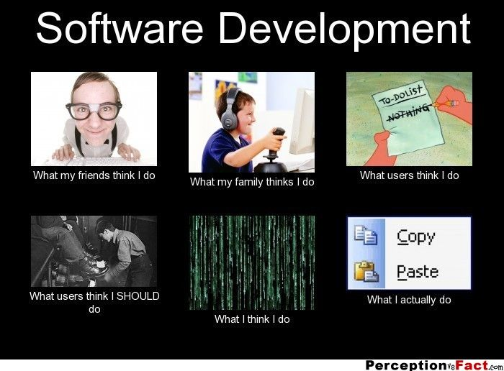
What you should expect as an SDE
You thought SD is like
Coding
Modeling
Algorithm Design
What SD is really like
Documentation
Meeting
Code Review/Approval/Integration
Copy/Paste

Slide 13
Overall Aim of this Course
To Become a Good Software Development Engineer (SDE)
You may be a super coder, mathematician, competitor, but not necessarily a good SDE
Being Aware of Continously Learning and Thinking
What you learned from this course is limited and will be outdated very soon
Think about the big picture, think smartly and non-technically
Do things that matter
Great Responsibility and Glorious Mission
The forth industry revolution
Create great product and create it in China
Export our IT product and service to the world

Slide 14
03
PART Three
Course Overview

Slide 15
Terminology: Stakeholders
Stakeholders are roles involved in a project
Client (甲方, PM)
Provides resources in exchange for software
Bears risk in event of project failure
Sets requirements, priorities
Client satisfaction is primary measure of project success
Developers (程序员)
Should be considered a stakeholder (but not the most important one)
Are also an expensive resource
Have responsibilities of competence, confidentiality, compliance
Customer （顾客）
Buys the software or selects it for use by an organization
User （用户）
Actually uses (interfaces with) the software

Slide 16
Software Development Process
Feasibility and planning
Requirements
User Interface/Experience design
System design
Program development (coding part)
Acceptance and release
Operation and maintenance
May be repeated during the development cycle
Distinguish among these steps
These are the major contents covered in this course and will be presented in your project report

Slide 17
Feasibility
A feasibility study precedes the decision to begin a project.
What is the scope of the proposed project? Is the project technically feasible? What are the projected benefits?
What are the costs? Are the resources available? What are the risks and how can they be managed?
A feasibility study leads to a decision: go or no-go

Slide 18
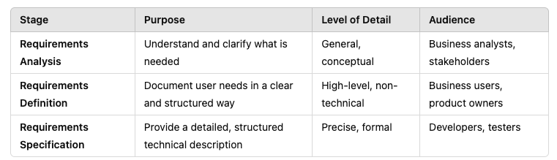
Requirements
Requirements define the function of the system from the client's viewpoint.
The requirements establish the system's functionality, constraints, and goals by consultation with the client, customers, and users.
This step is sometimes divided into:
Requirements analysis
Requirements definition
Requirements specification
The requirements may be developed in a self-contained study, or may emerge incrementally.
Failure to agree on the requirements and define them adequately is one of the biggest cause of software projects failing.

Slide 19
User Interface/Experience (UI/UX)
Usability is of great importance in many modern applications and software systems. Requires good user interface design
User interfaces need to be evaluated with users. This requires iterative development
Design the user interface Test with users Revise the user interface Repeat
Product driven, NOT tech driven
There are many reasons why a product fails, but a ugly product will definitely fail

Slide 20
System Design
Design describes the system from the software developers' viewpoint
System design
Establish a system architecture, both hardware and software, that matches the requirements.
Security and performance are parts of the system design
Models
Models are often used to represent the requirements, system design, and program design
This course teaches the basic concepts of the Unified Modeling Language (UML)
You should 得意忘形！

Slide 21
Program Development
Takes the system design and user interface design and builds programs that meet the requirements.
Program design (design pattern)
Implementation (coding)
Testing

Slide 22
Testing
User testing Versions of the user interface are tested by users. Their experience may lead
to changes in the requirements or the design.
Program testing The development team tests components individually (unit testing) or in
combination (system testing) against the design to find bugs, etc.
Acceptance testing
The client tests the final version of the system or parts of the system against the requirements.

Slide 23
Acceptance and Release
Acceptance Testing
The system is tested against the requirements by the client
That’s why requirement engineering is so IMPORTANT
Delivery and Release
After successful acceptance testing, the system is delivered to the client and released into production or marketed to customers

Slide 24
Operation and Maintenance
Operation
The system is put into practical use
Maintenance
Errors and problems are identified and fixed
Evolution
The system evolves over time as requirements change, to add new functions, or adapt to a changing technical environment
Phase out
The system is withdrawn from service This is sometimes called the Software Life Cycle.

Slide 25
04
PART Four
More to Know

Slide 26
Variety
Variety
Software must serve many different purposes, in many different settings, for many different people.
Project variety demands developer versatility.
There is no “best” way to create software in all cases.
Function, Time, Cost
A software engineer must know a wide variety of methods & tools and select appropriate ones for the project at hand.

Slide 27
Risk
Many (probably most) software development projects run into difficulties.
DeepSeek v.s. ChatGPT
Problems:
Does not work as expected (FUNCTION)
Over budget (COST)
Late delivery (TIME)
Competing goals:
Every software project has a trade-off between function, cost, and time.
Extra function adds extra costs for development, testing, maintenance, etc.
Consequences
Failed projects can bankrupt companies.
Managers can lose their jobs
Users and society may be harmed

Slide 28
Minimizing Risk: Communication
As much as half of delivered software is never used
Developers build the “wrong software” – doesn’t meet client’s needs
The software development team must:
Understand what the client expects of the software
Understand what the client's organization expects of the client
Understand what customers and users expect of the software
Developer may add technical insights, but client satisfaction measures project success.
Product driven, NOT tech driven!

Slide 29
Minimizing Risk: Communication
Feasibility studies
Whether to begin a project
Separate of requirements from design
What the client wants v.s. how the developers meet the requirements
Milestones and releases
How the developers report or demonstrate progress to the clients
Acceptance and user testing
How the client tests that the software meets the requirements
Handover
Ensuring that the client receives a package that can be operated and maintained over a long time period

Slide 30
Minimizing Risk: Visibility
The people who take the responsibility must know what is happening
The people who decide your promotion or quit must know what you have contributed
Manager
Must rely on others for reports of progress or difficulties
Software Developer: Have difficulty evaluating progress Are usually humble about achievement
Consider reporting a waste of time
Prompt in action and prudent in claim 敏于行而讷于言

Slide 31
Minimizing Risk: Short Dev Cycle
Risk is minimized by frequent delivery of working software weeks rather than months.
Client, customers, and users can evaluate the developers' work
Opportunities to adapt to changing circumstances This is one of the basic principles of agile software development

Slide 32
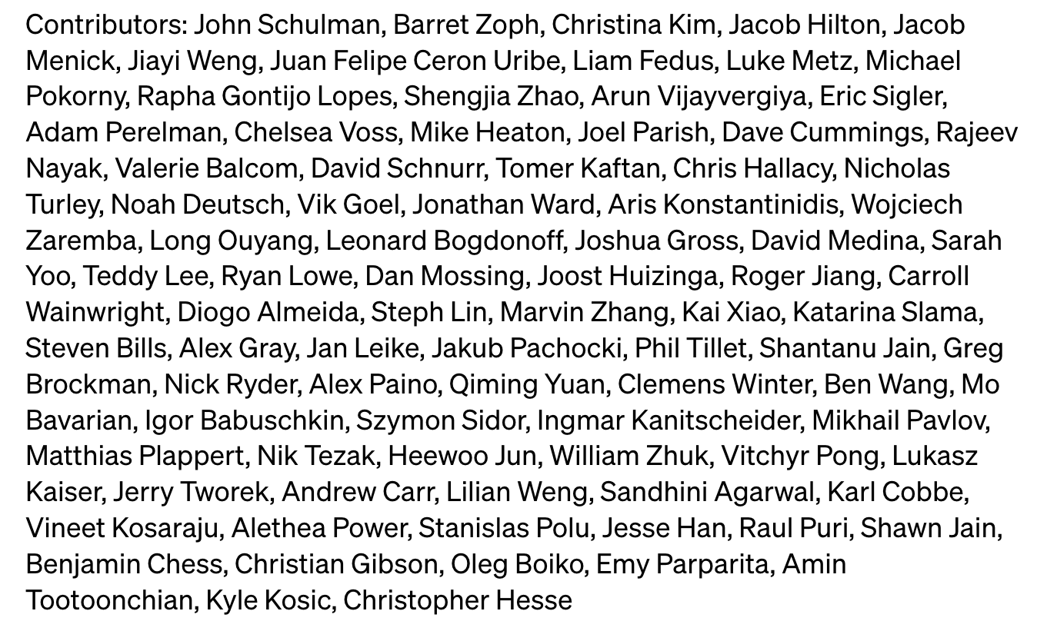
Scale
System Aspect
Large and very large systems may be totally different in function, cost and time
The requirements have changed many times
Human Resource Aspect
May contain 100 to 10,000+ person/years
Nobody comprehends the entire project
Frequent turnover of staff

Slide 33
Management
Project management Track progress against schedule
Prioritize tasks
Personnel management
Allocate the right number of developers with the right skills at the right time Ensure that developers have a productive work environment
Compliance advising Understand legal, regulatory, economic environment
Development processes Enforce best practices to minimize risk without excessive overhead

Slide 34
A good process lead to good software
reduce risk
enhance visibility
enable teamwork

Slide 35
Thanks for your listening!
Instructor: Liu, Guangchi Ph.D.
2025/02/21

